Slide 1
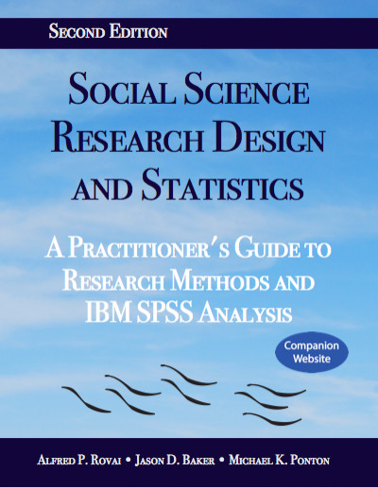
Social Science Research Design and Statistics, 2/e Alfred P. Rovai, Jason D. Baker, and Michael K. Ponton
Kolmogorov-Smirnov Test
PowerPoint Prepared by Alfred P. Rovai
IBM® SPSS® Screen Prints Courtesy of International Business Machines Corporation,
© International Business Machines Corporation.

Slide 2
Uses of the Kolmogorov-Sminov Test
The Kolmogorov-Smirnov test (also known as the K-S test or one-sample Kolmogorov-Smirnov test) is a nonparametric procedure that determines whether a sample of data comes from a specific distribution, i.e., normal, uniform, Poisson, or exponential distribution.
It is mostly used for evaluating the assumption of univariate normality by taking the observed cumulative distribution of scores and comparing them to the theoretical cumulative distribution for a normally distributed variable.

Slide 3
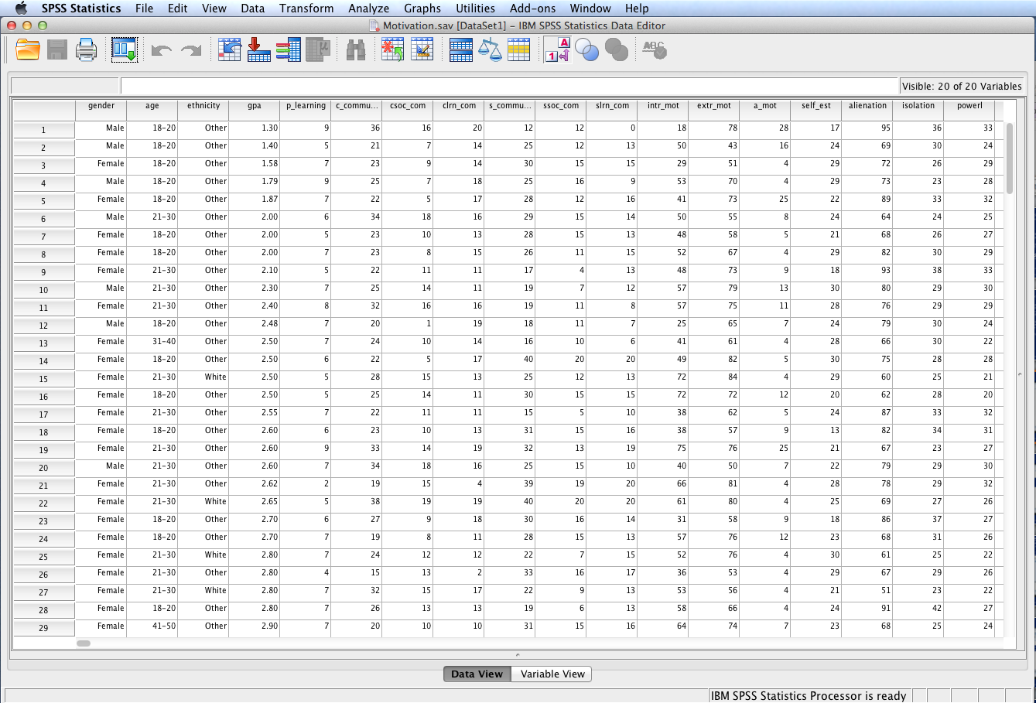
Open the dataset Motivation.sav.
File available at http://www.watertreepress.com/stats

Slide 4
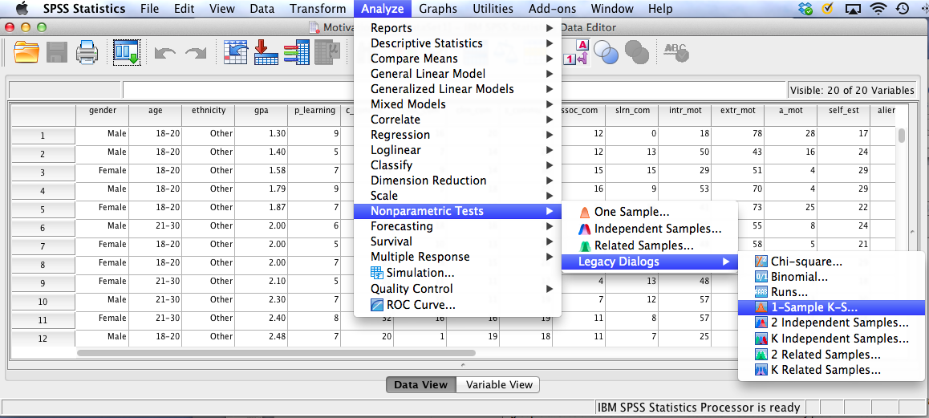
Follow the menu as indicated to conduct the K-S test using Legacy Dialogs. Alternatively, one can run the test using the One-Sample option under the Nonparametric Tests menu or the Explore option in the Descriptive Statistics menu.
Note: N = 169 in the active dataset; if N < 50, the Shapiro-Wilk test should be used to evaluate normality.

Slide 5
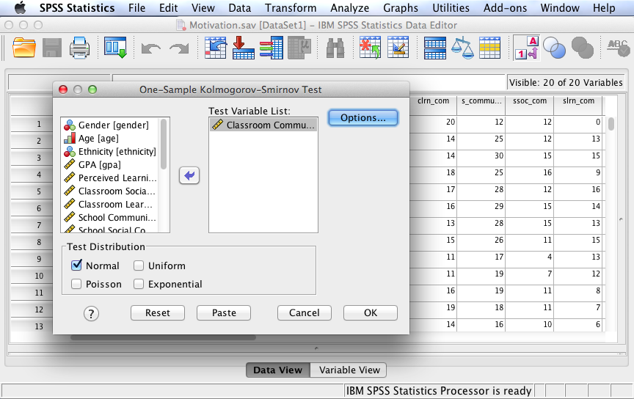
In this example, we will test the following null hypothesis:
H_{o}: There is no difference between the distribution of sense of classroom community data and a normal distribution.
Move Classroom Community to the Test Variable List: box. Check Normal as the Test Distribution. Click Options.

Slide 6
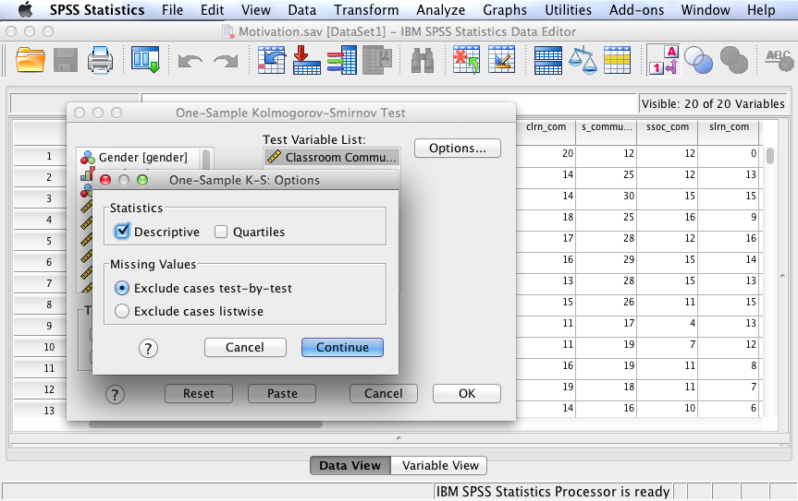
Check Descriptive to generate descriptive statistics output. Click Continue and then OK to run the test.

Slide 7
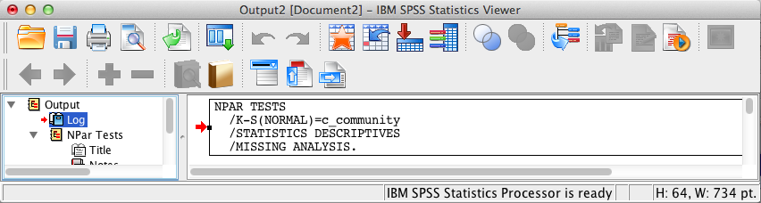
SPSS Output
The contents of the SPSS Log is the first output entry. The Log reflects the syntax used by SPSS to generate the NPar Tests output.

Slide 8
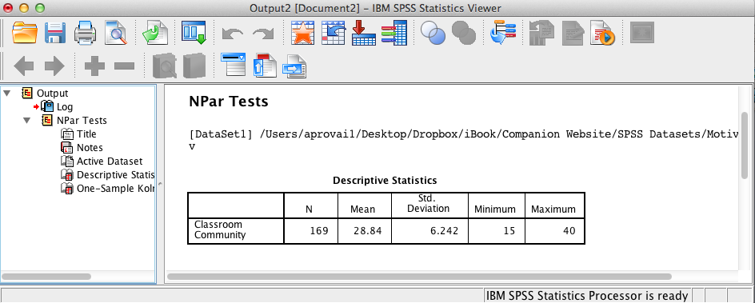
SPSS Output
The above SPSS output displays descriptive statistics.

Slide 9
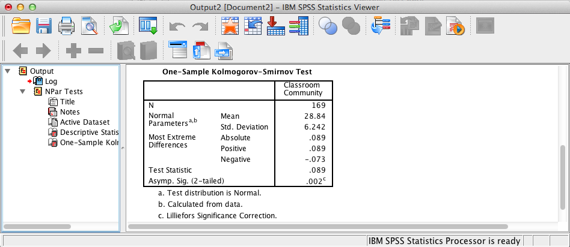
SPSS Output
The above SPSS output shows a significant relationship, D = .09, p = .002, since the asymptotic significance level <= .05 (the assumed à priori significance level).

Slide 10
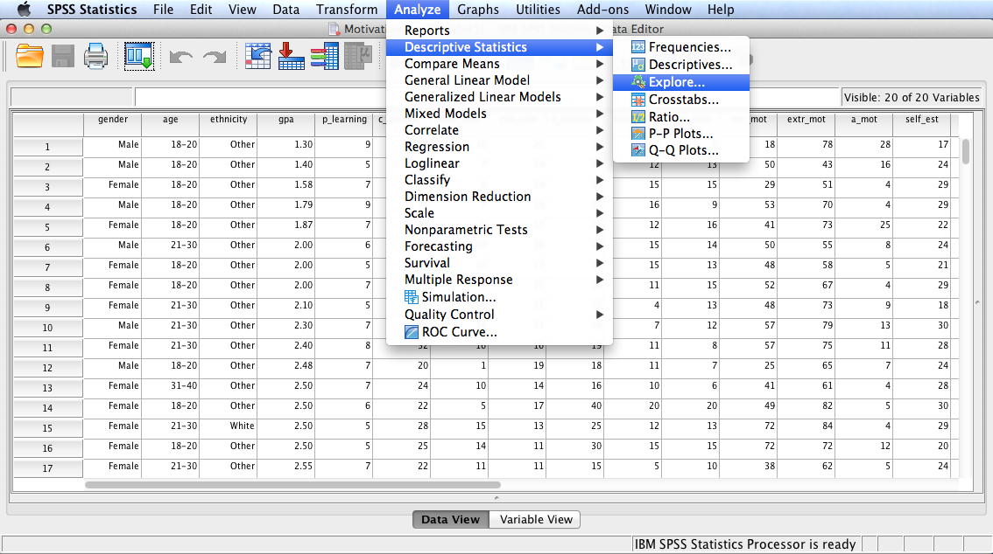
Follow the menu as indicated to conduct the K-S test using the Explore option in the Descriptive Statistics menu.

Slide 11
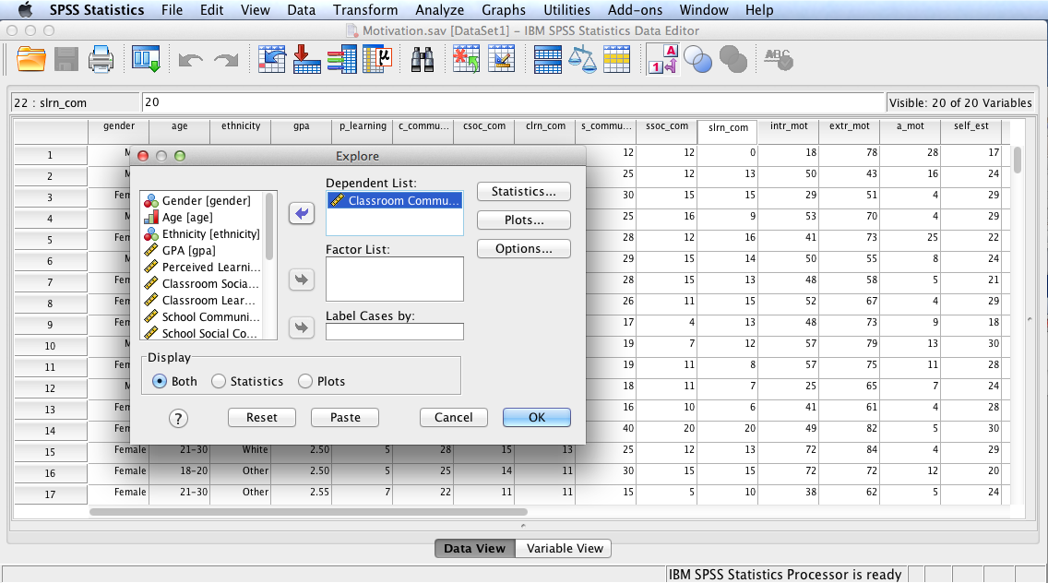
Move Classroom Community to the Dependent List: box. Click Plots.
Note: optionally, you can also select one or more factor variables, e.g., gender, whose values will define groups of cases. Output will provide results disaggregated by the categories within each factor, e.g., K-S test results will be provided for male and female distributions of classroom community.

Slide 12
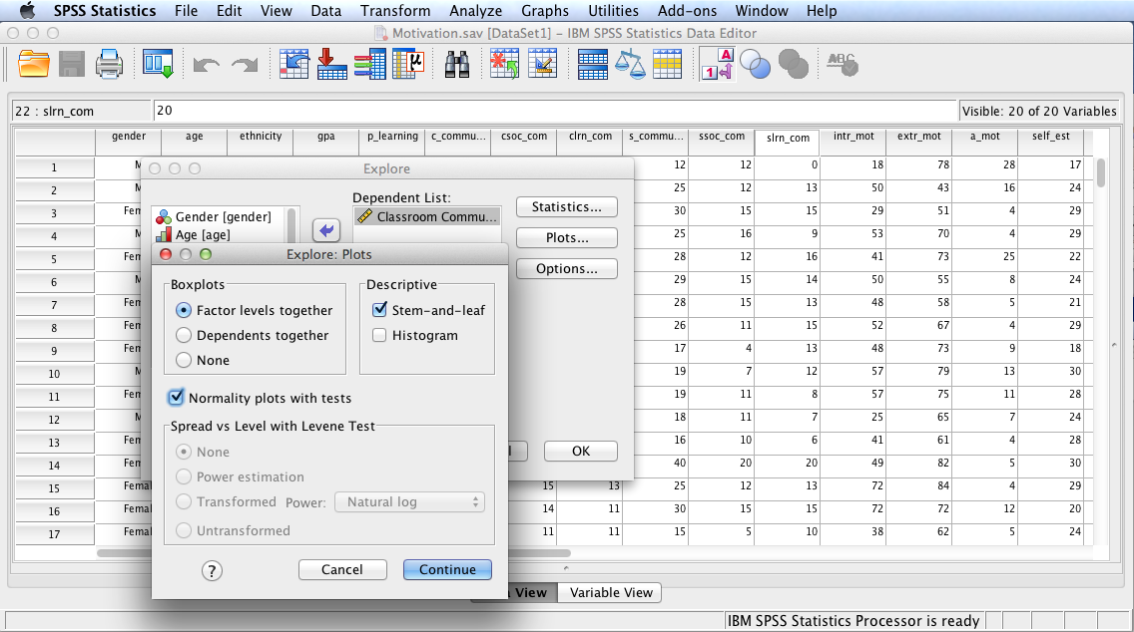
Select Normality plots with tests. Check Histogram, if desired. Click Continue and then OK to run the procedure.

Slide 13
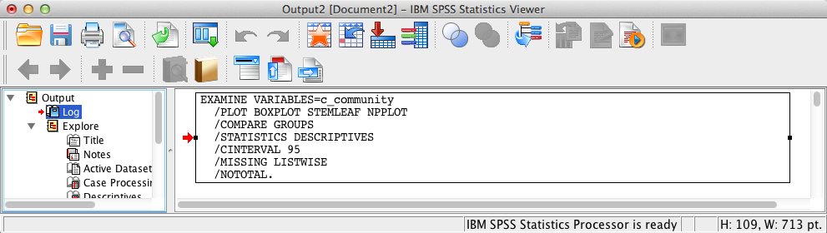
SPSS Output
The contents of the SPSS Log is the first output entry. The Log reflects the syntax used by SPSS to generate the Explore output.

Slide 14
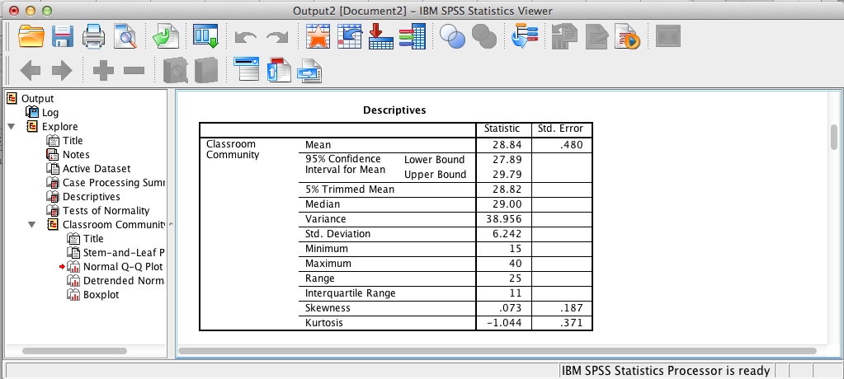
SPSS Output
Output includes descriptives. Kurtosis statistics are of special interest. The standard coefficient of kurtosis = – 1.044/.371 = – 2.81, indicating a pronounced platykurtic distribution that suggests a non-normality since the coefficient < – 2.00.

Slide 15
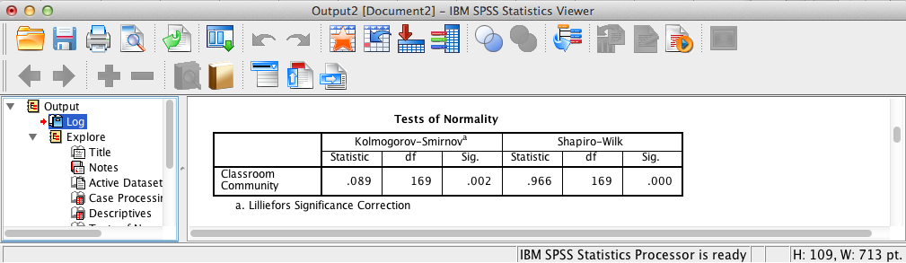
SPSS Output
The relevant part of the output is the above table on tests of normality. The results, as expected, are the same as the results obtained using the Legacy Dialogs procedure (i.e., the results are statistically significant since p < .05.)
Note: Shapiro-Wilk test results should be ignored in this example since N > 50.

Slide 16
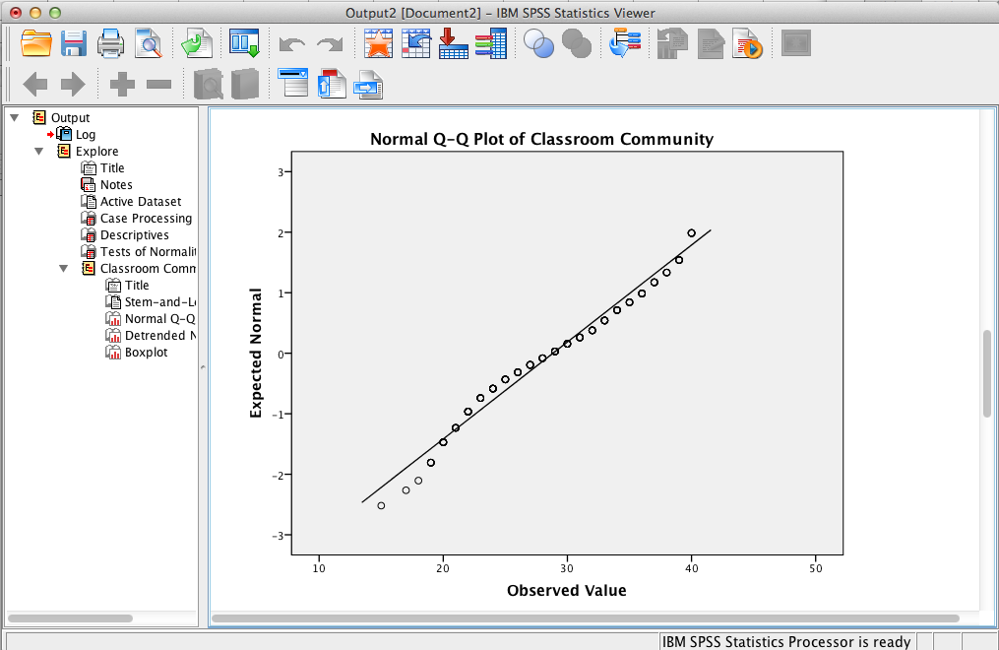
SPSS Output
SPSS output includes other relevant material to assist in evaluating normality, such as this Q-Q plot, which supports the conclusion of a non-normal distribution.

Slide 17
Kolmogorov-Smirnov Test Results Summary
H₀: There is no difference between the distribution of sense of classroom community data and a normal distribution. Test results are significant, D (169) = .09, p = .002, providing evidence to reject the null hypothesis. Consequently, it is concluded that classroom community scores are not normally distributed.

Slide 18
End of Presentation

